Slide 1
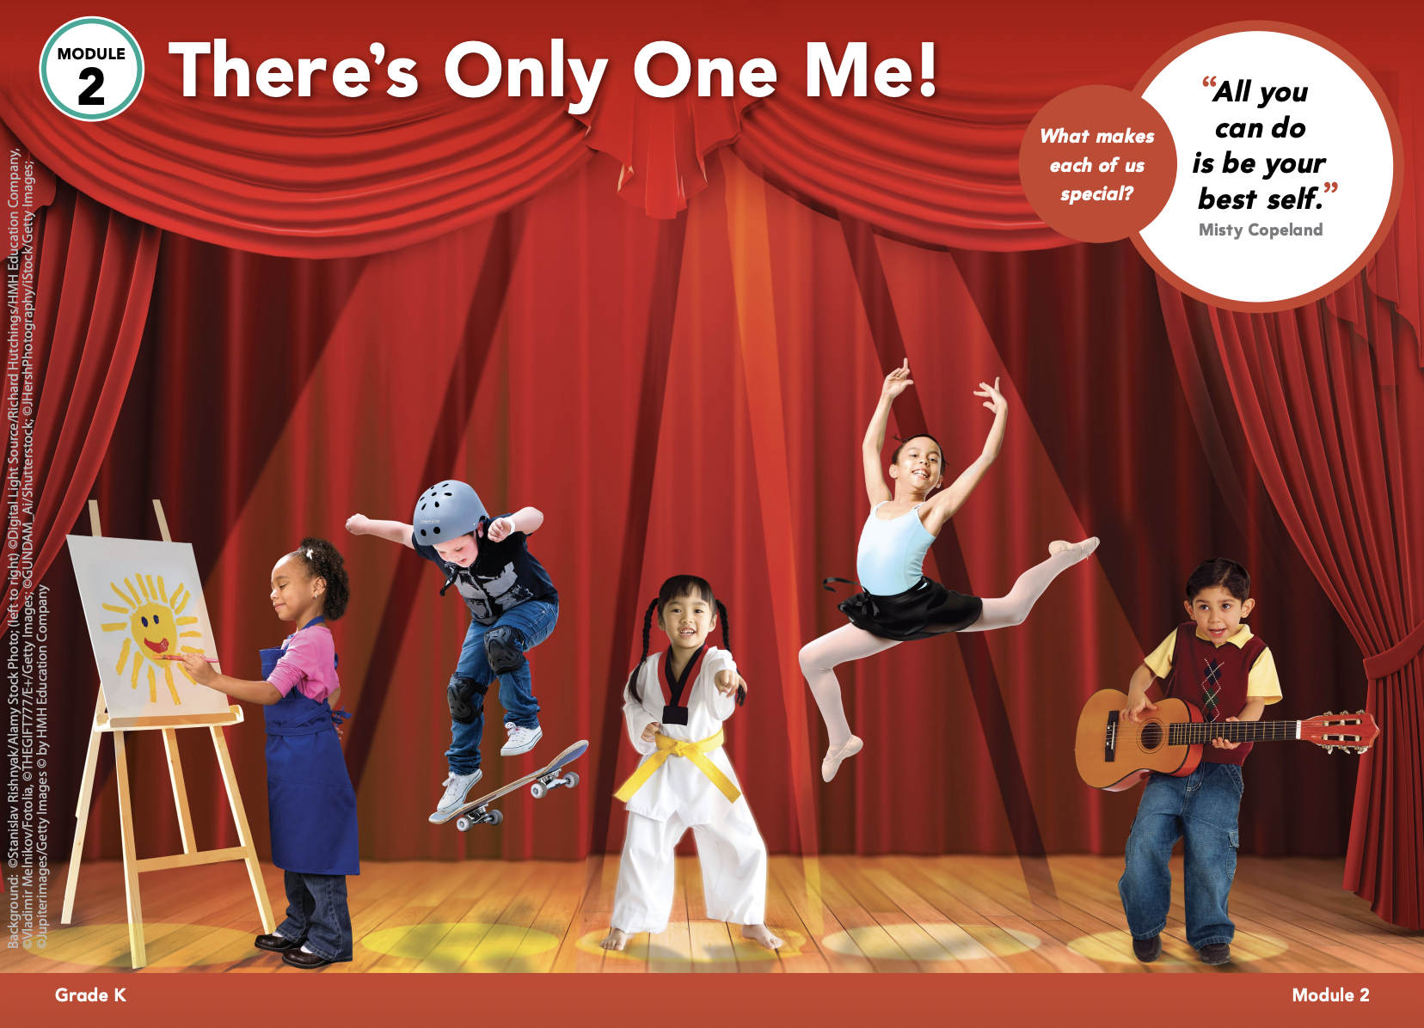
BACK
HOME

Slide 2
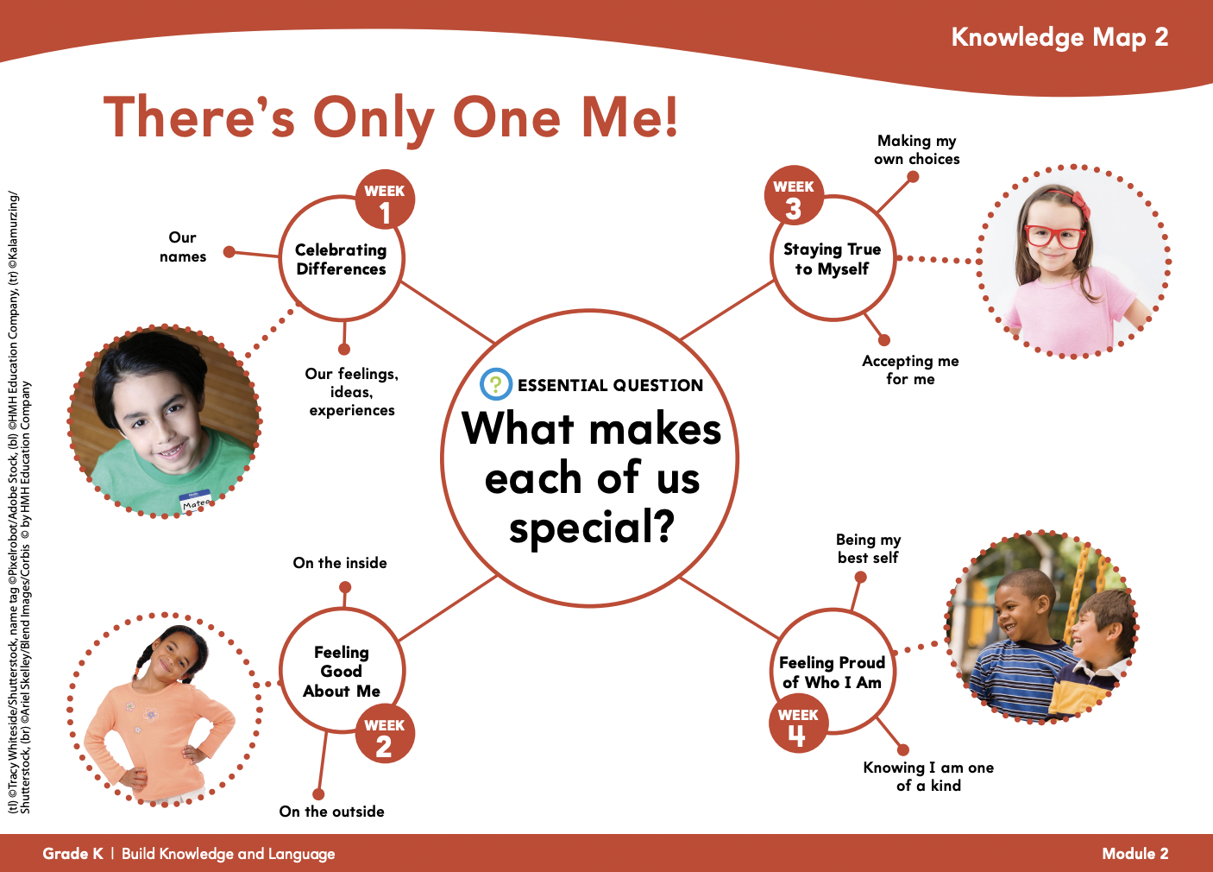
BACK
HOME

Slide 3
BACK
HOME

Slide 4
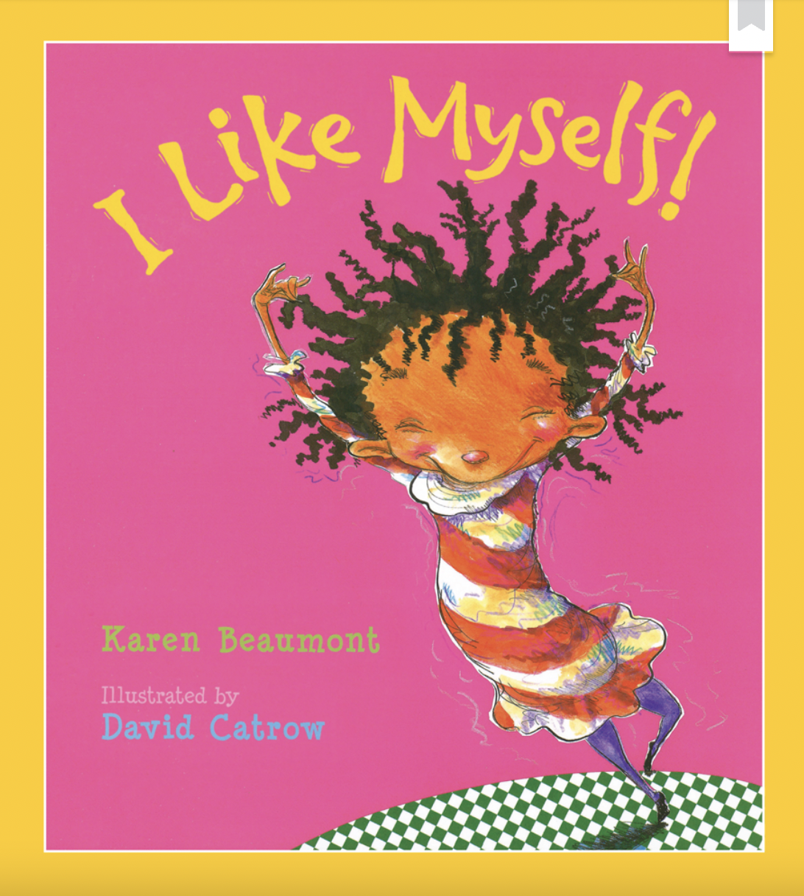
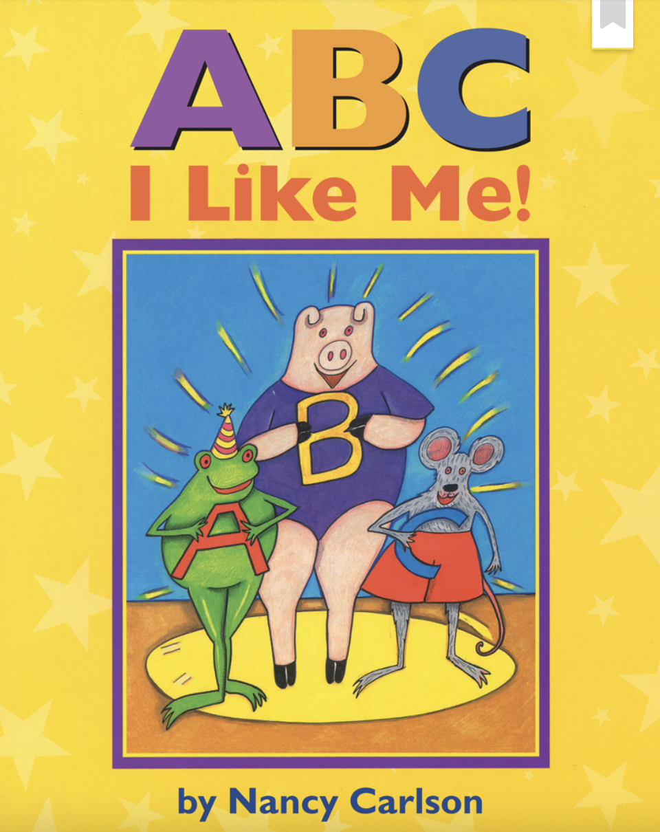
Books of the Week
BACK
HOME

Slide 5
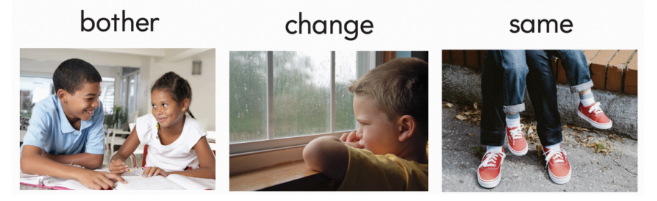
Vocabulary
When you celebrate, you do something fun to remember a special person or event. Let’s have a party to celebrate your birthday. | If something is different, it is not the same. The red flower is different from the others. | Something is special if it is different from others. A peacock is special because it has colorful feathers.
BACK
HOME

Slide 6
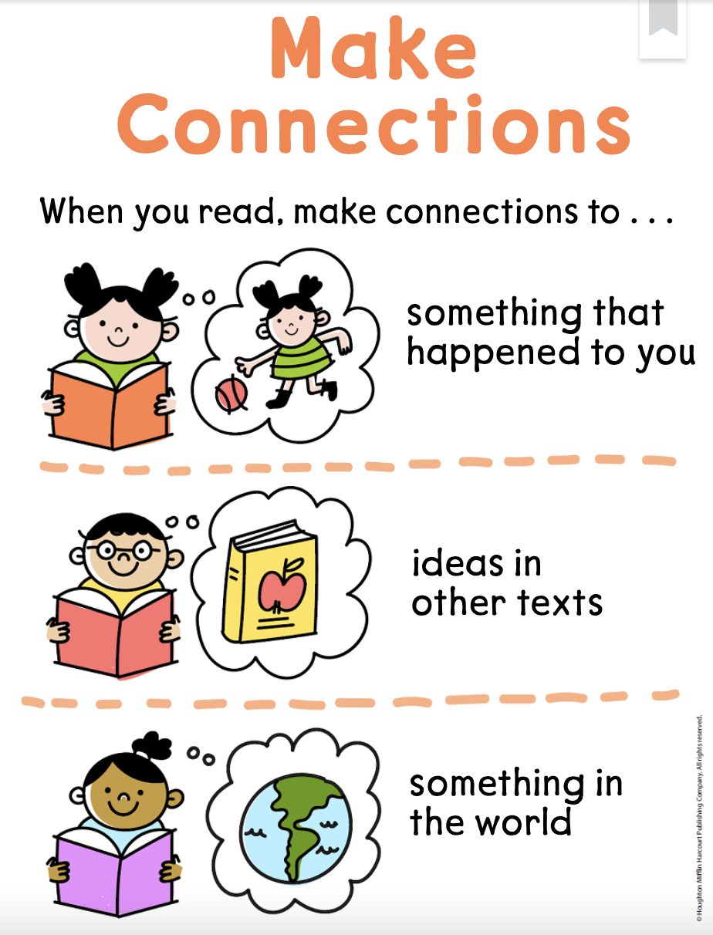
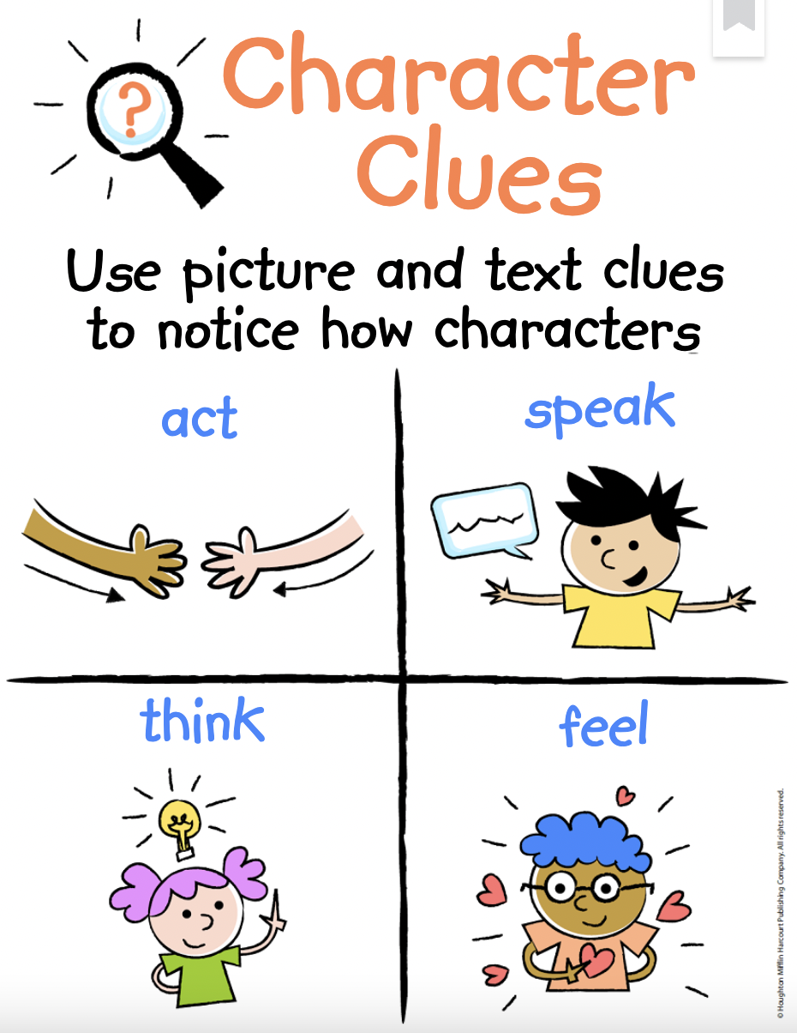
Reading Focus
BACK
HOME

Slide 7
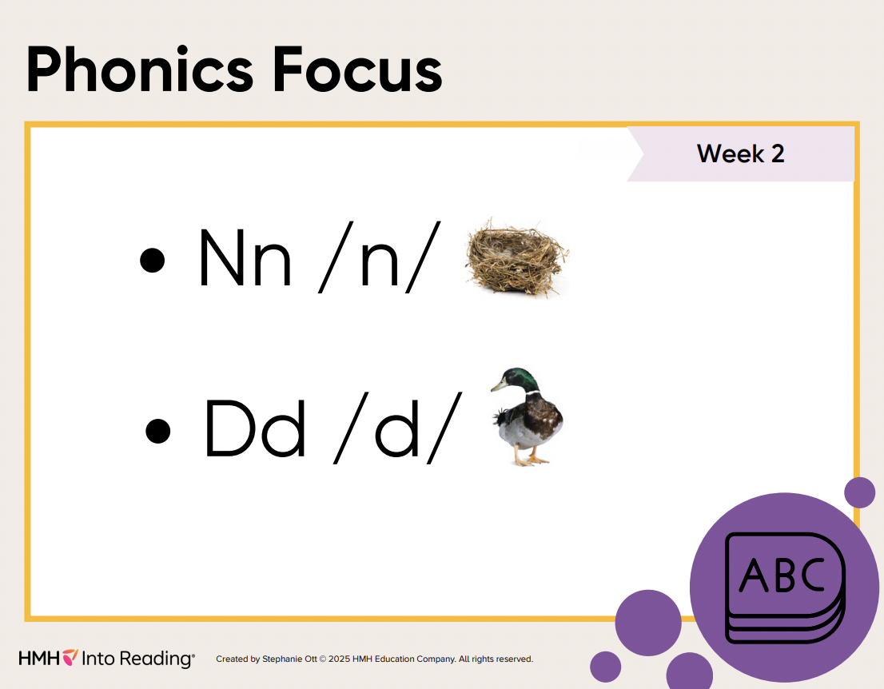
BACK
HOME

Slide 8
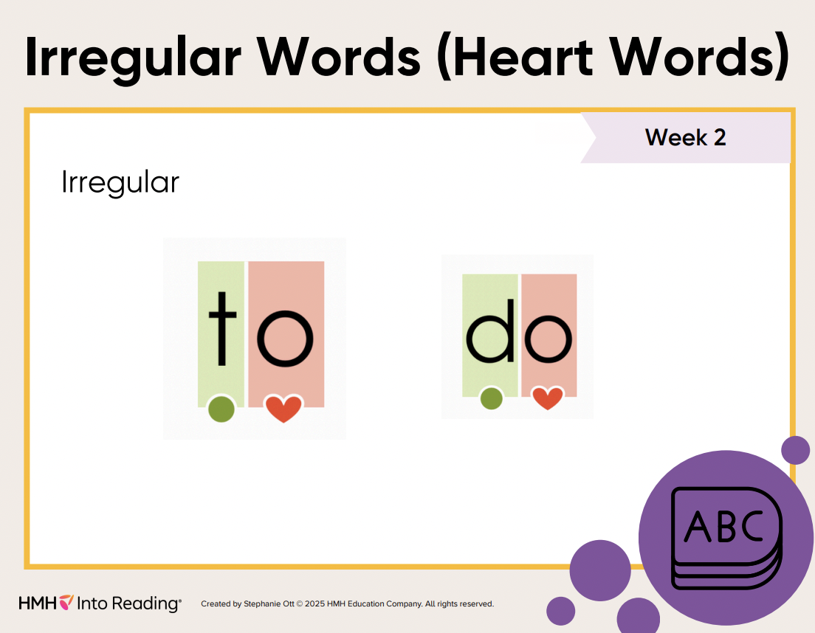
BACK
HOME

Slide 9
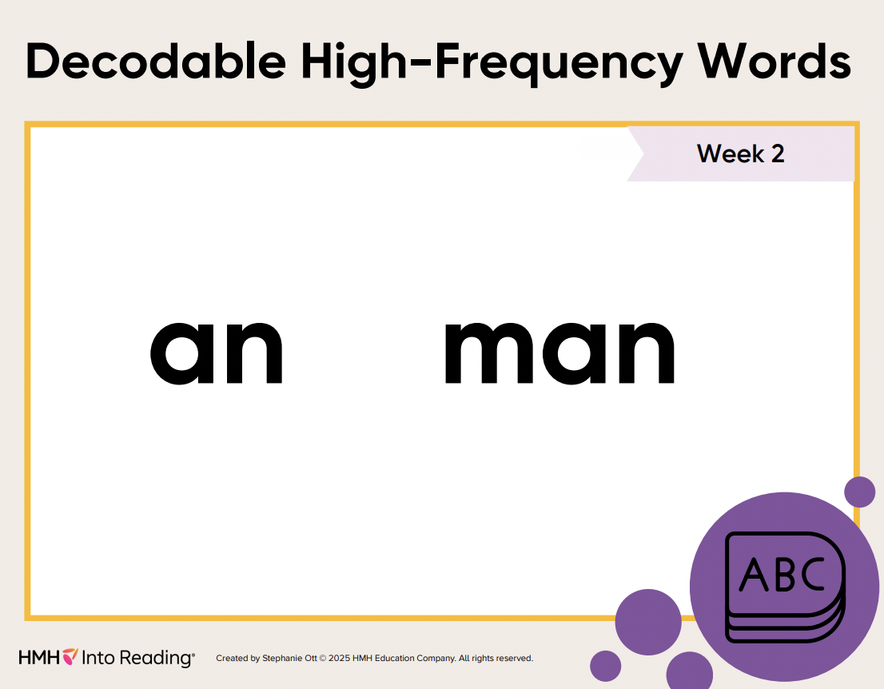
BACK
HOME

Slide 10
Previous Weeks
BACK
HOME

Slide 11


Books of the Week
BACK
HOME

Slide 12
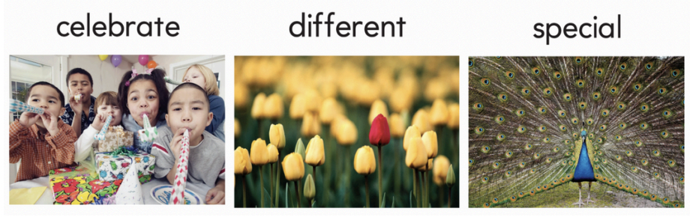
Vocabulary
When you celebrate, you do something fun to remember a special person or event. Let’s have a party to celebrate your birthday. | If something is different, it is not the same. The red flower is different from the others. | Something is special if it is different from others. A peacock is special because it has colorful feathers.
BACK
HOME

Slide 13

Vocabulary
To participate in an activity means to do an activity with others. At the end of the school year, my friends and participate in a tug of war. | To pronounce a word means to say it in the correct way. When I read aloud a book, I try to pronounce each word carefully. | To research means to look for information that answers questions about a topic. Hildy went to the library to research information for her science project.
BACK
HOME

Slide 14
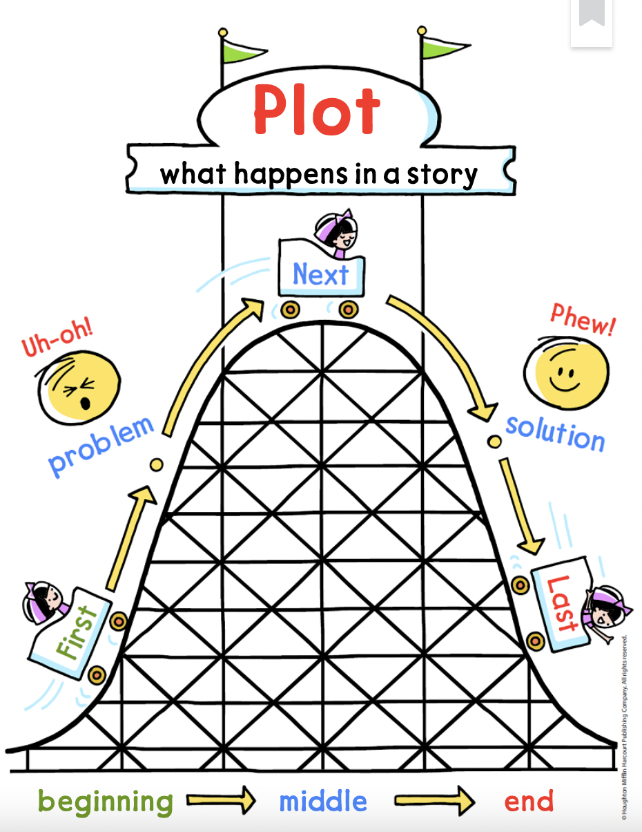
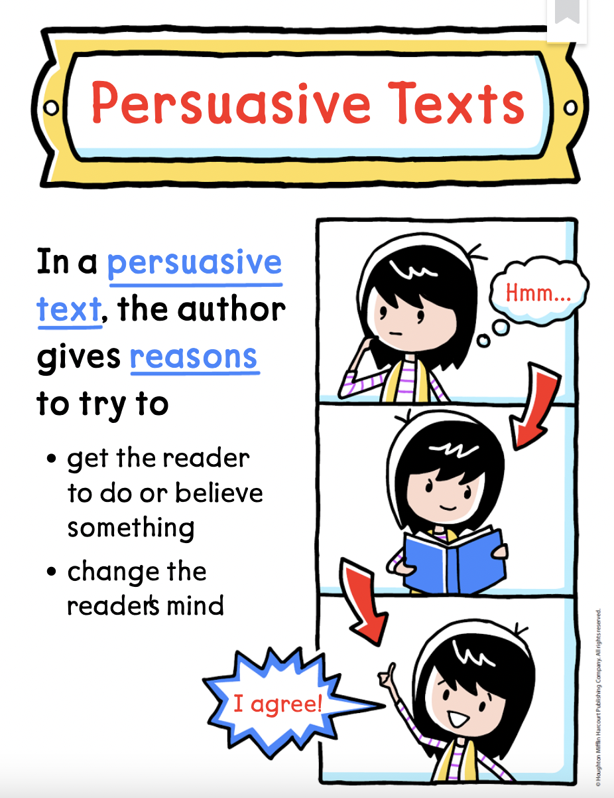
Reading Focus
BACK
HOME

Slide 15
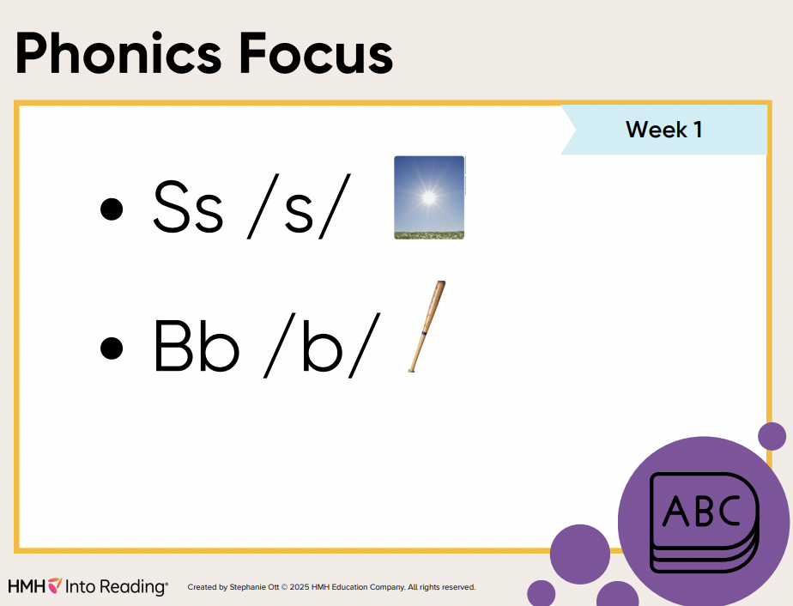
BACK
HOME

Slide 16
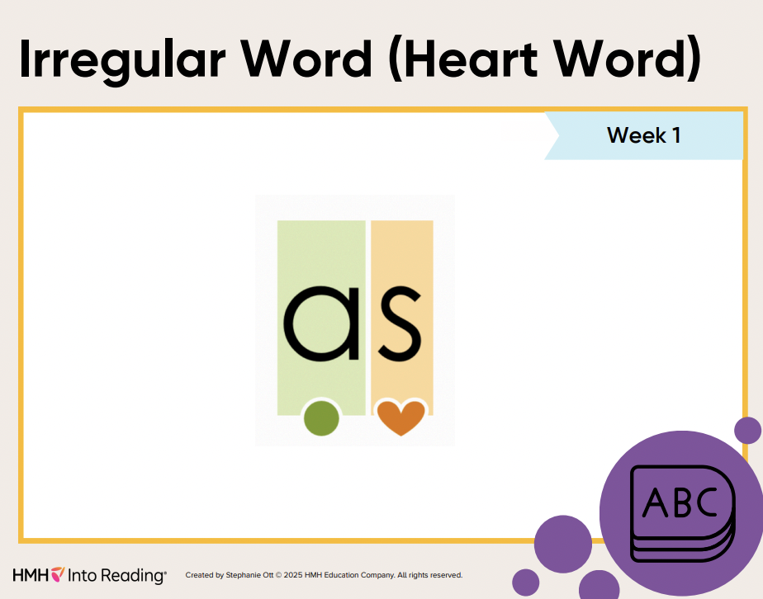
BACK
HOME

Slide 17

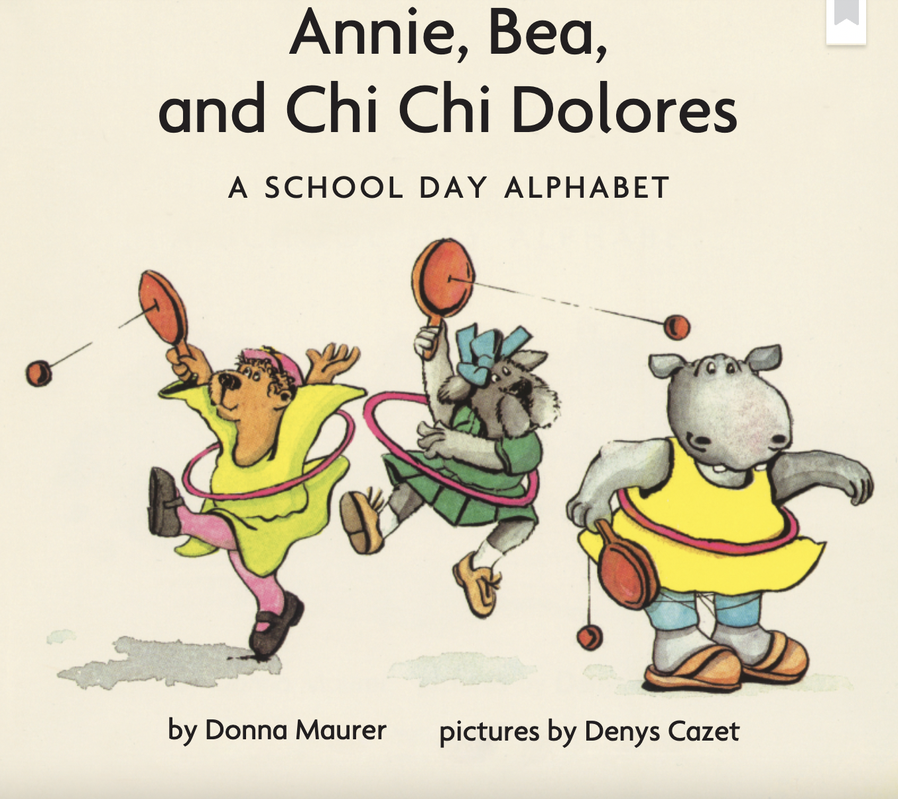
Books of the Week
BACK
HOME

Slide 18
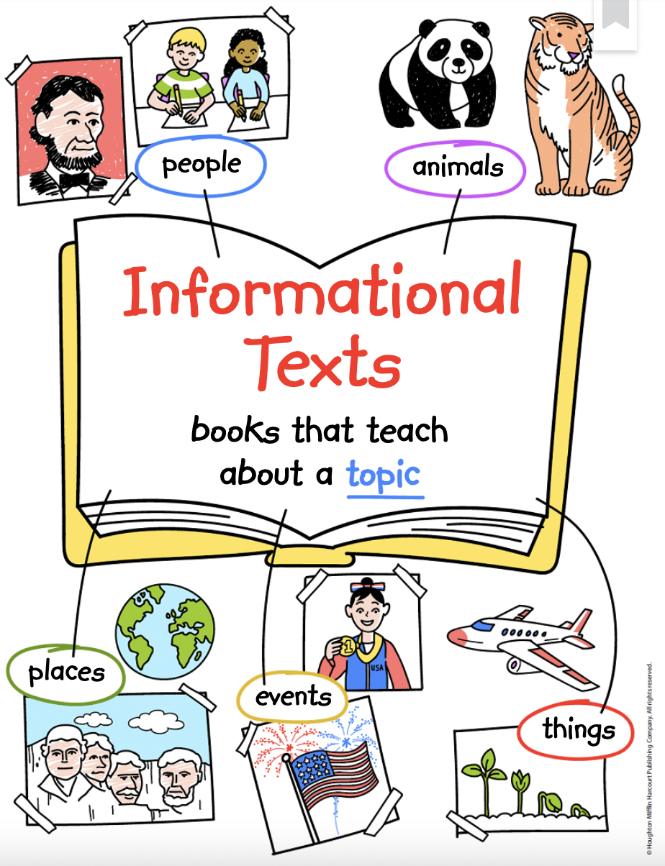
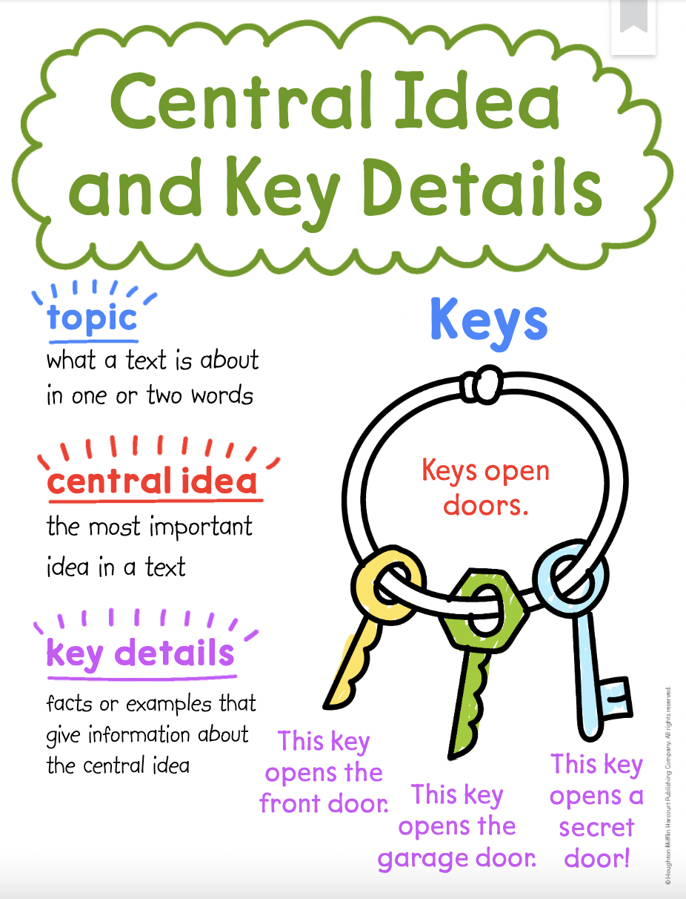
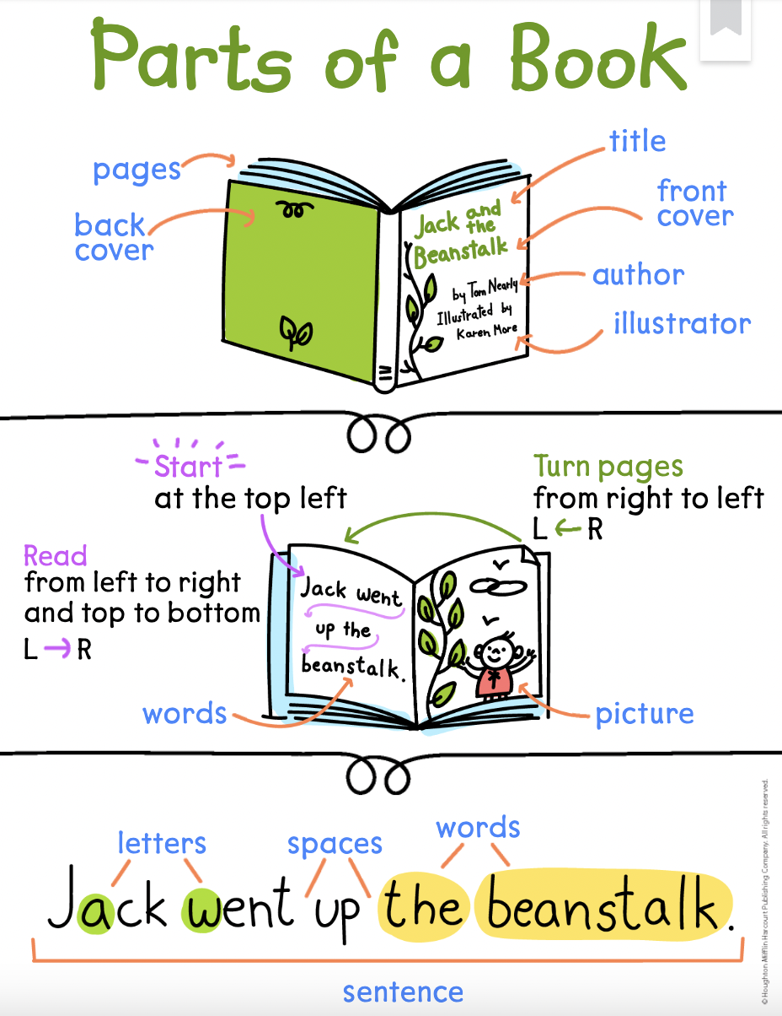
Reading Focus
BACK
HOME

Slide 19
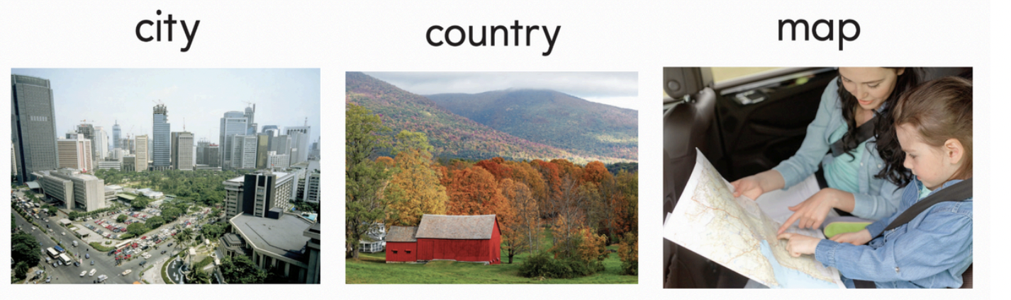
Vocabulary
A city is a place where many people live and work close together. There are lots of people, buildings, and cars in the city. | When you are in the country, you are far away from big towns and cities. There are a lot of trees and fields in the country. | A map is a picture or drawing that shows streets, rivers, and other parts of a place. We look at the map to see what roads to take on our trip.
BACK
HOME

Slide 20
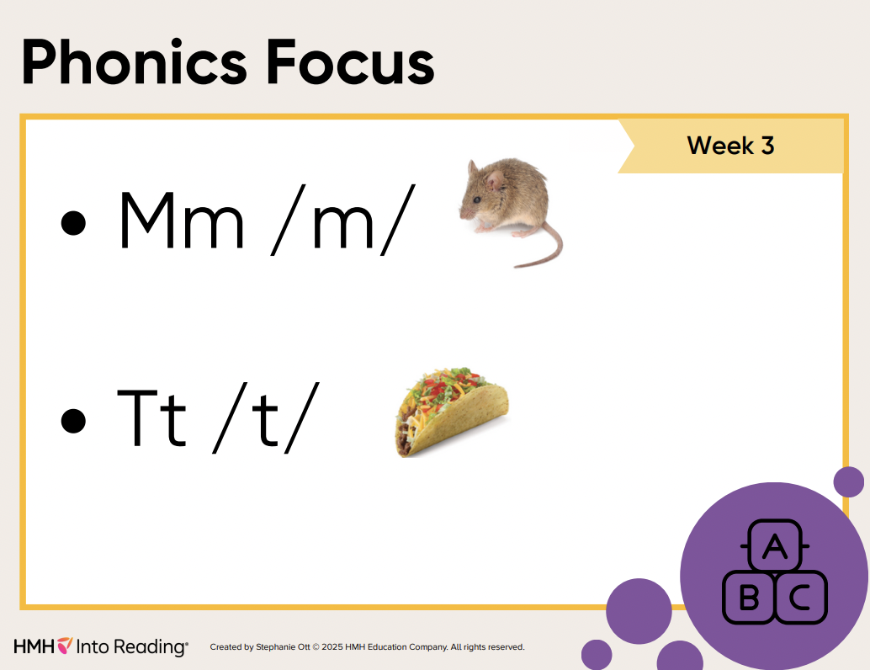
BACK
HOME

Slide 21
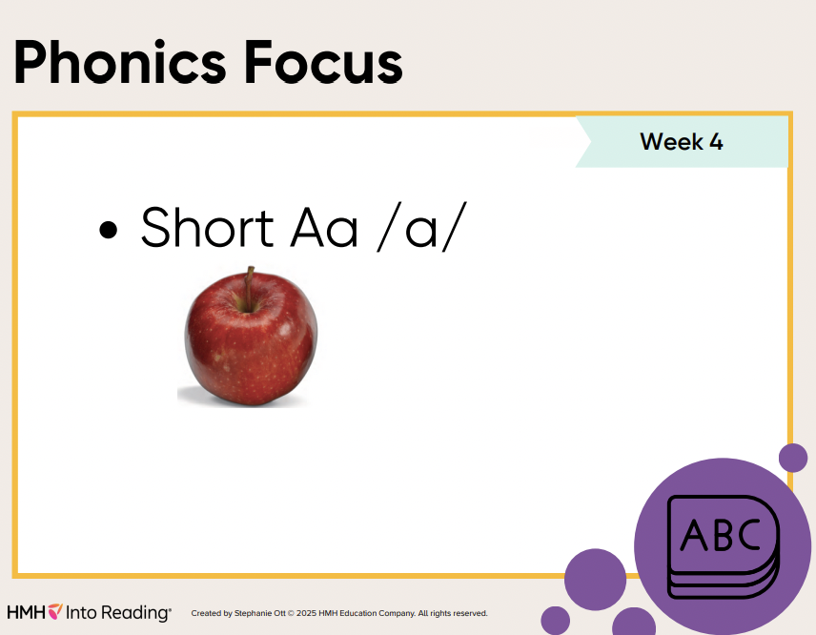
BACK
HOME

Slide 22
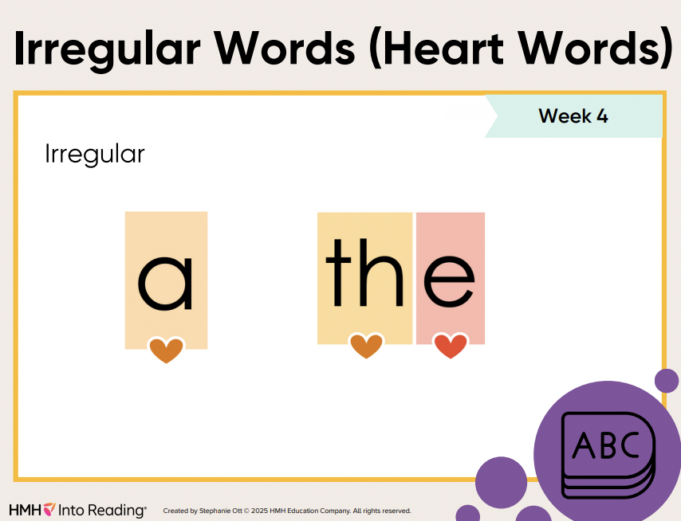
BACK
HOME

Slide 23
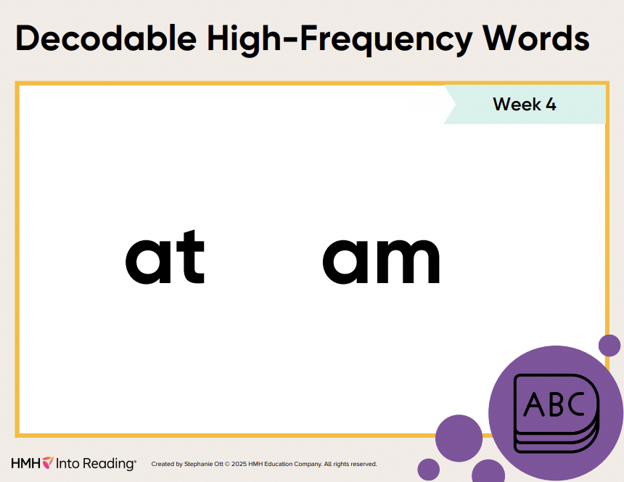
BACK
HOME

Slide 24
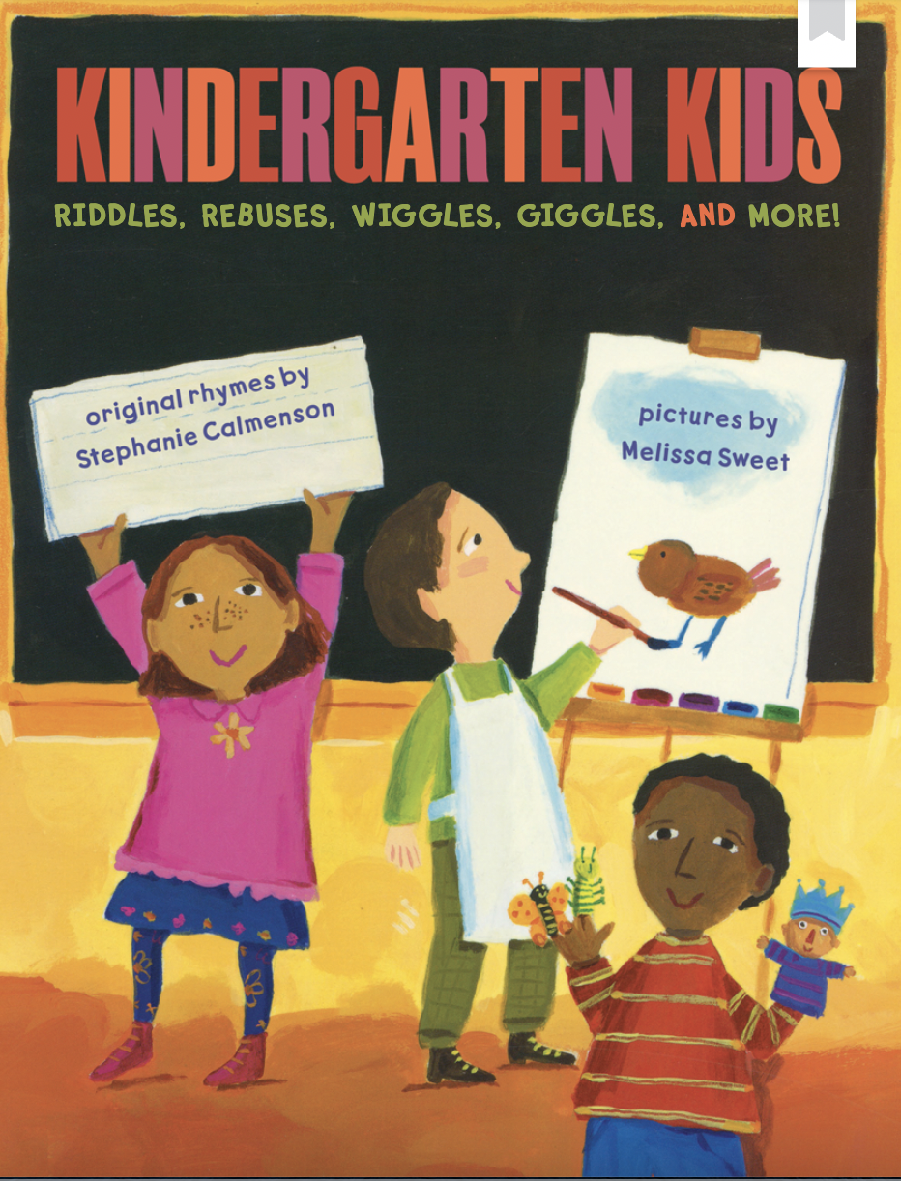

Books of the Week
BACK
HOME

Slide 25
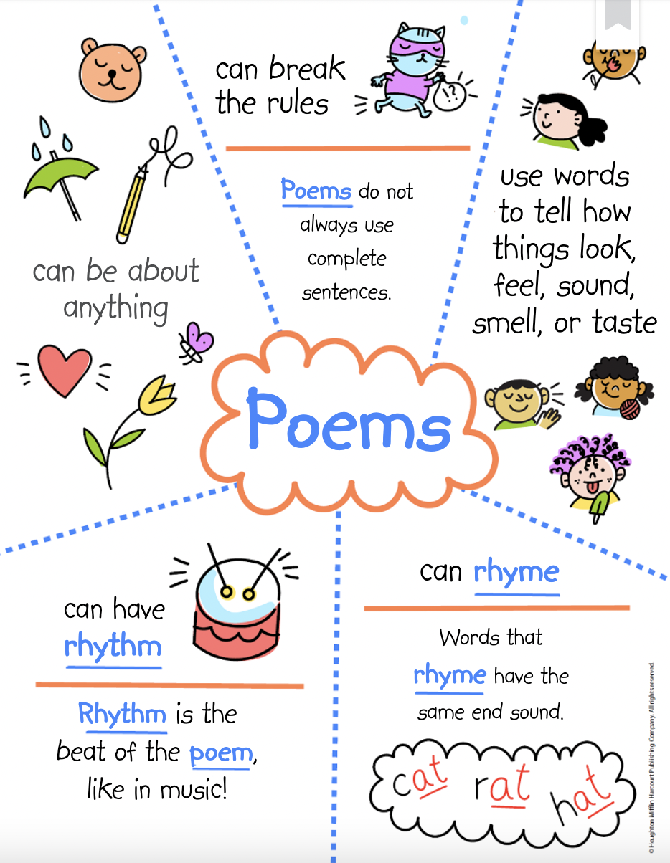
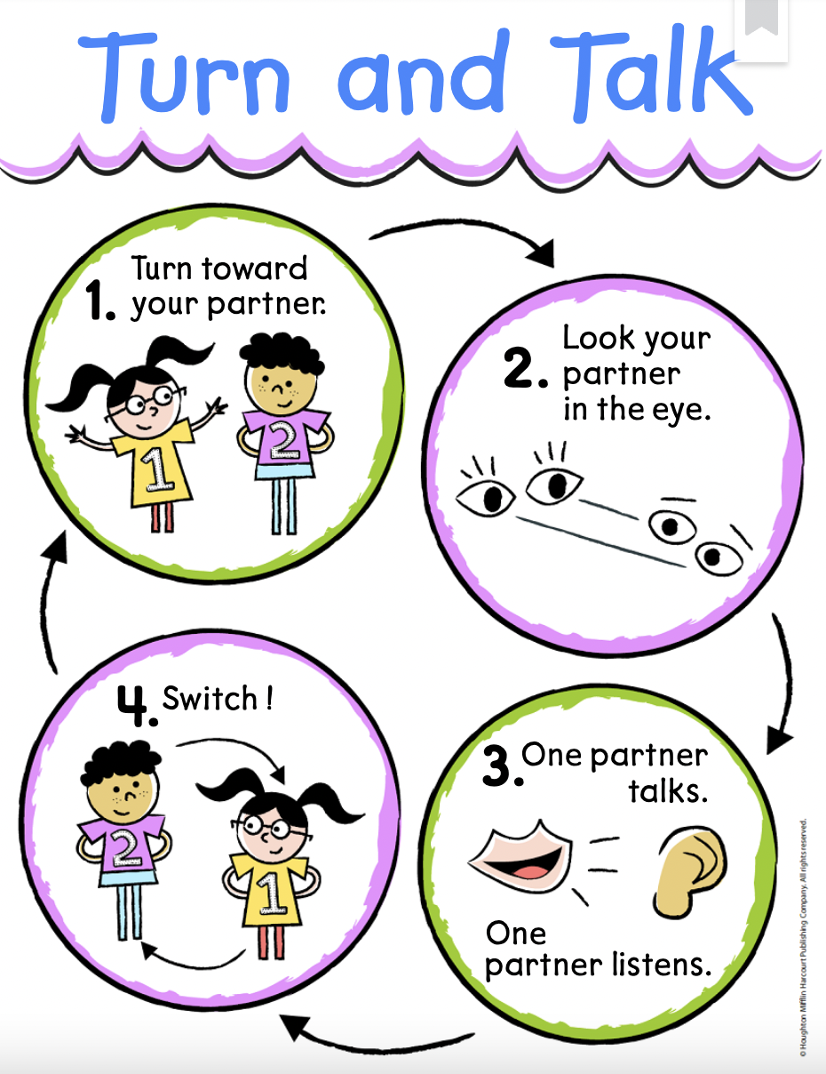
Reading Focus
BACK
HOME

Slide 26
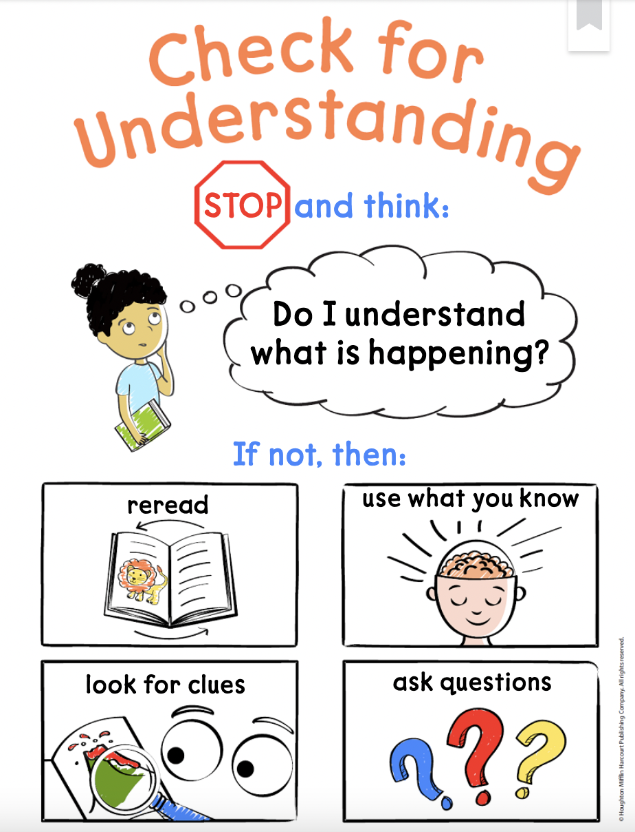
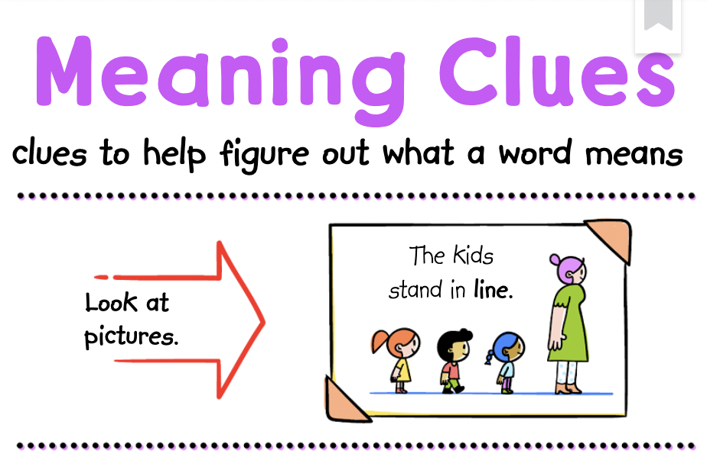
Reading Focus
BACK
HOME

Slide 27
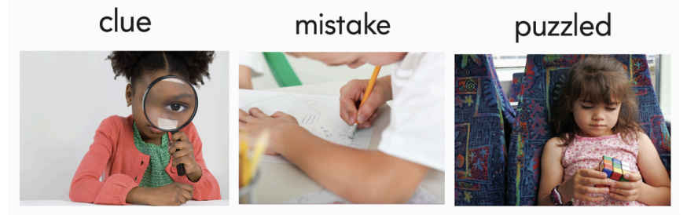
Vocabulary
A clue is information that helps you find something or solve a problem. I looked closely for a clue to find the missing lunch box. | When you make a mistake, you do something the wrong way. My teacher told me it's OK to make a mistake as long as I try hard. | If you are puzzled, you are not sure what to do. The girl is puzzled by the game she is playing.
BACK
HOME

Slide 28
BACK
HOME

