Slide 1
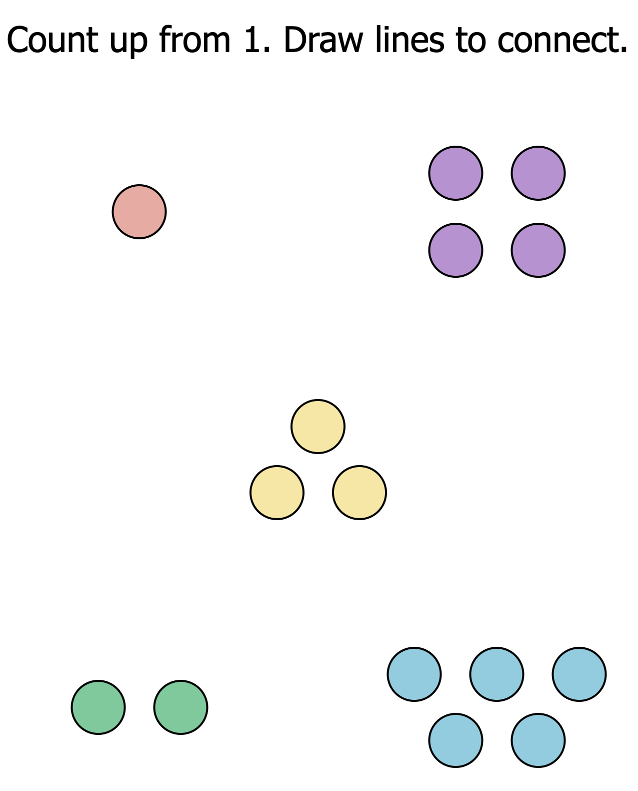
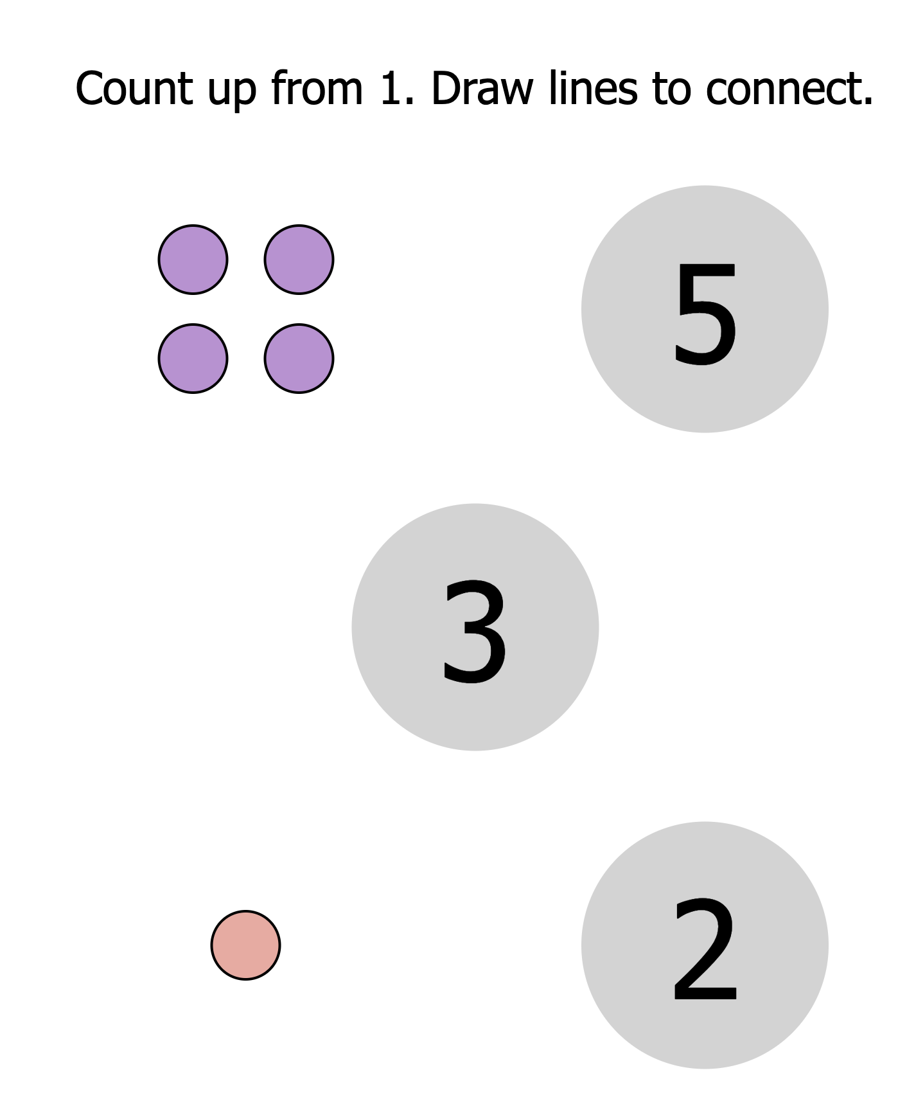
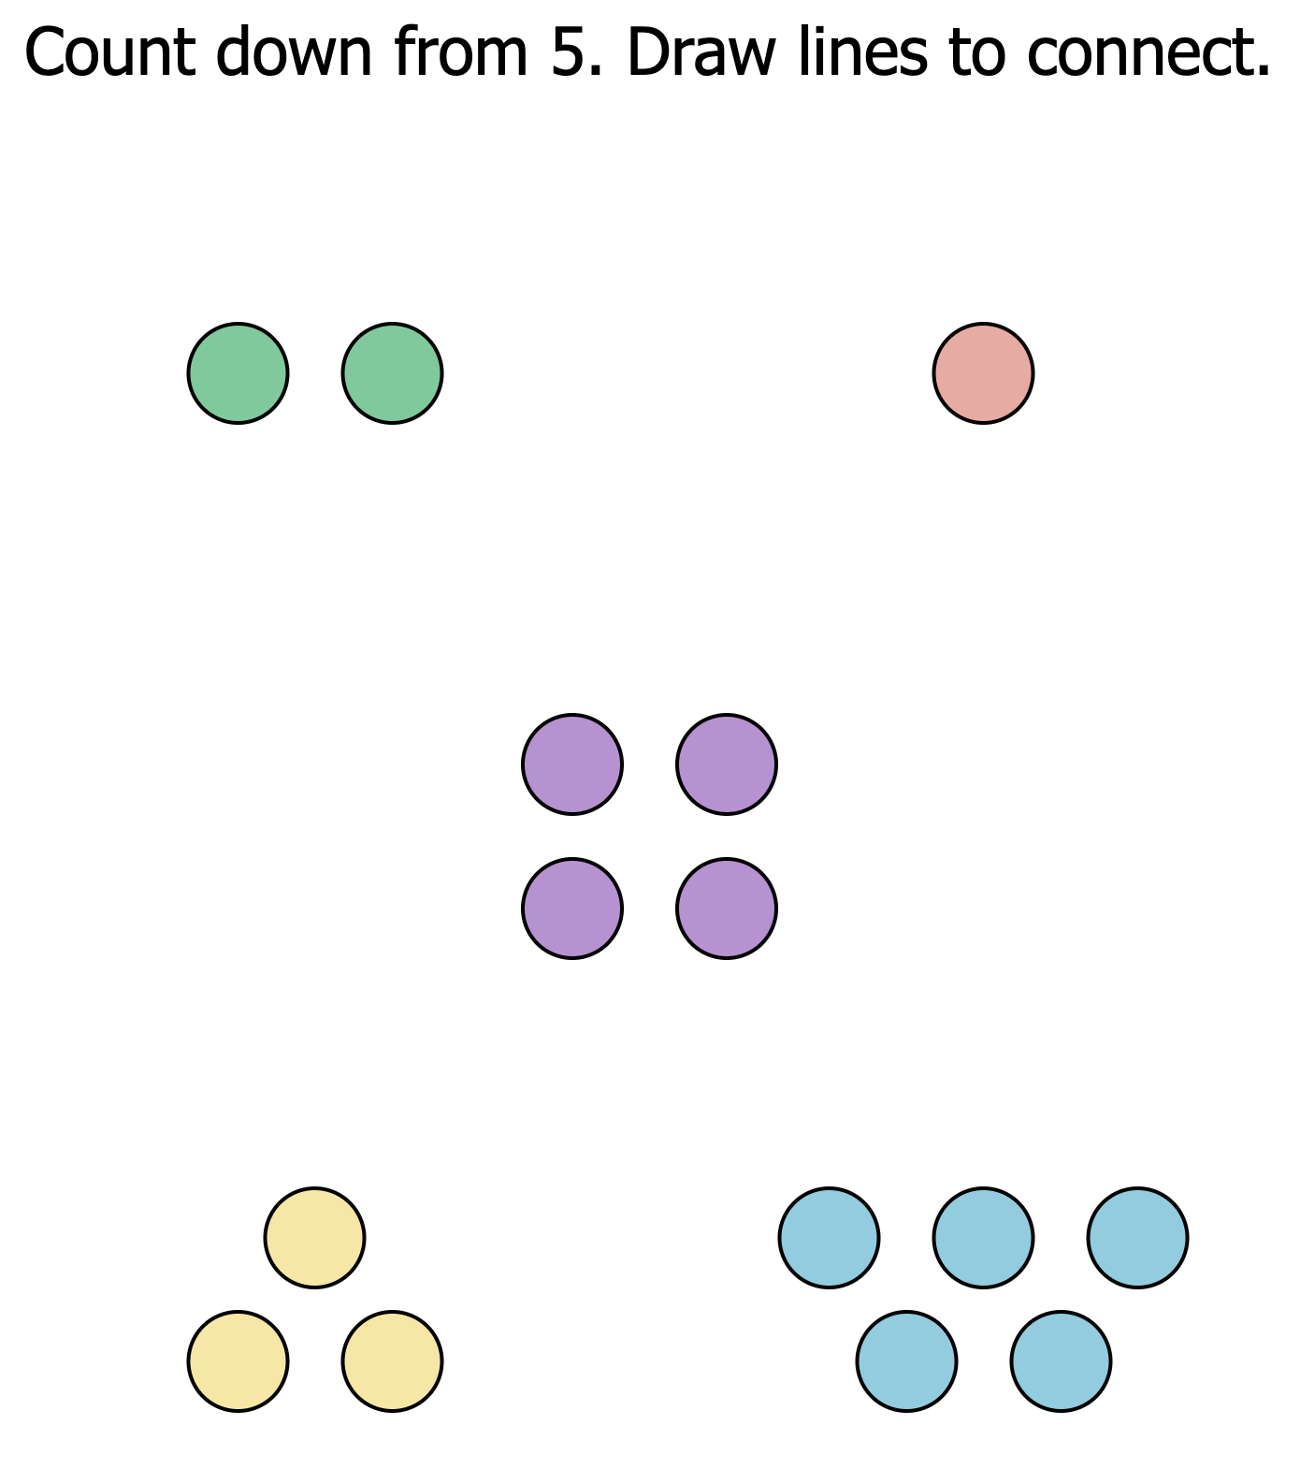
Counting Up and Down 1-5
BACK
HOME

Slide 2


Subitizing to 5
BACK
HOME

Slide 3
Previous Weeks
BACK
HOME

Slide 4
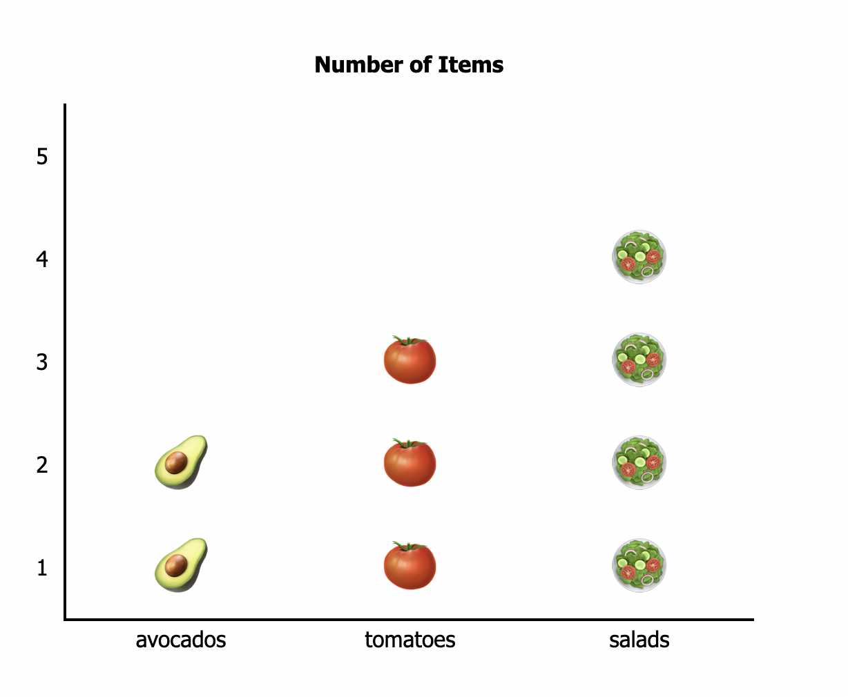
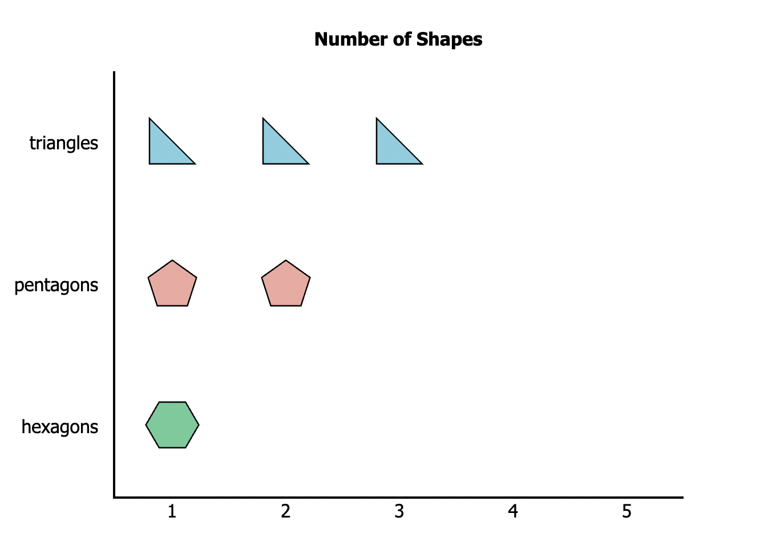
Graphs and Data
BACK
HOME

Slide 5
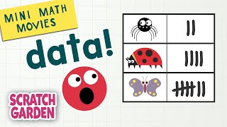
Graphs and Data
BACK
HOME

Slide 6
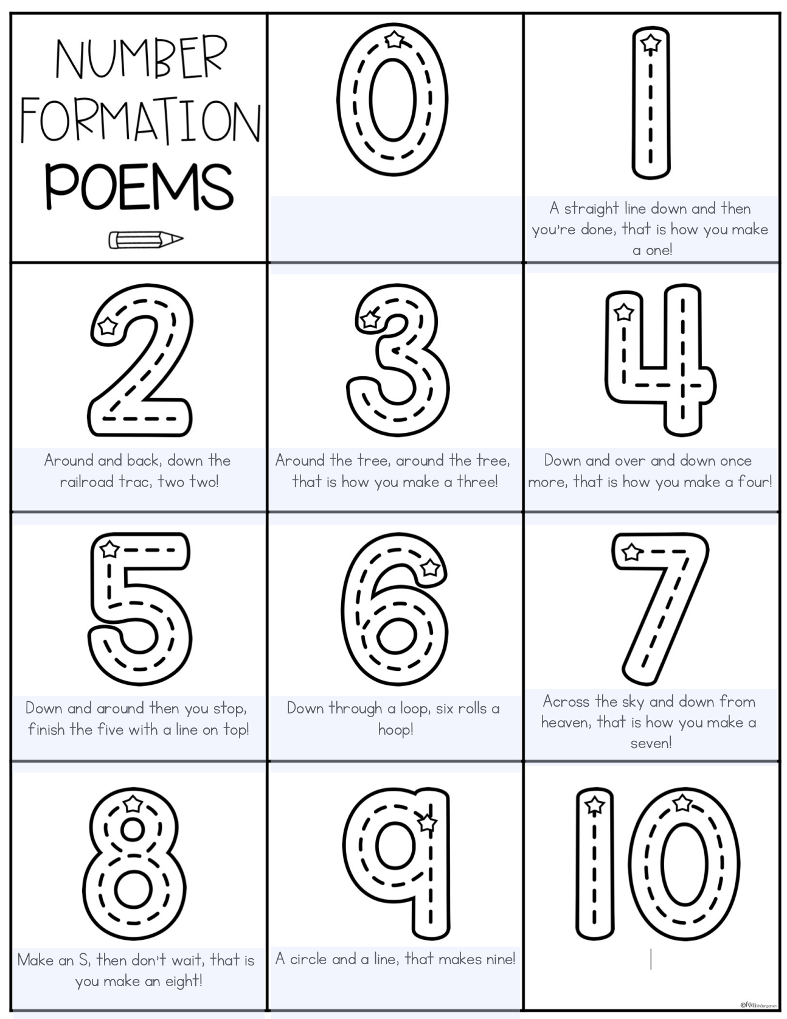
Number Formation 1 - 9
BACK
HOME

Slide 7
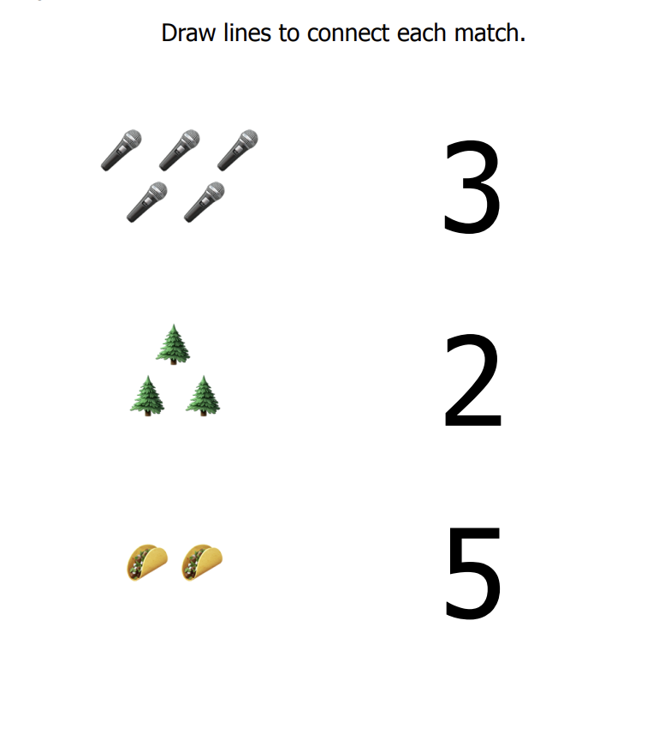
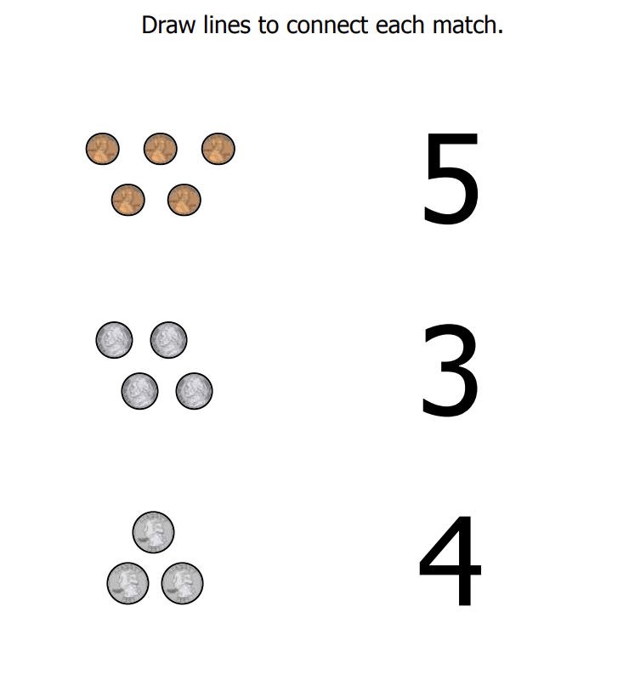
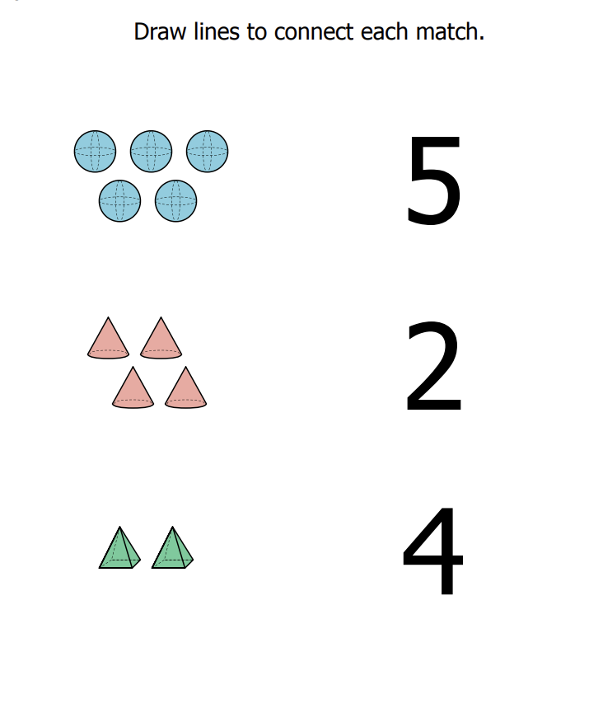
Matching Numbers and Quantities
BACK
HOME

Slide 8
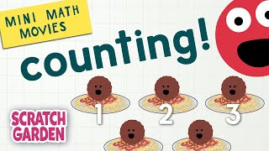
Counting
BACK
HOME

Slide 9
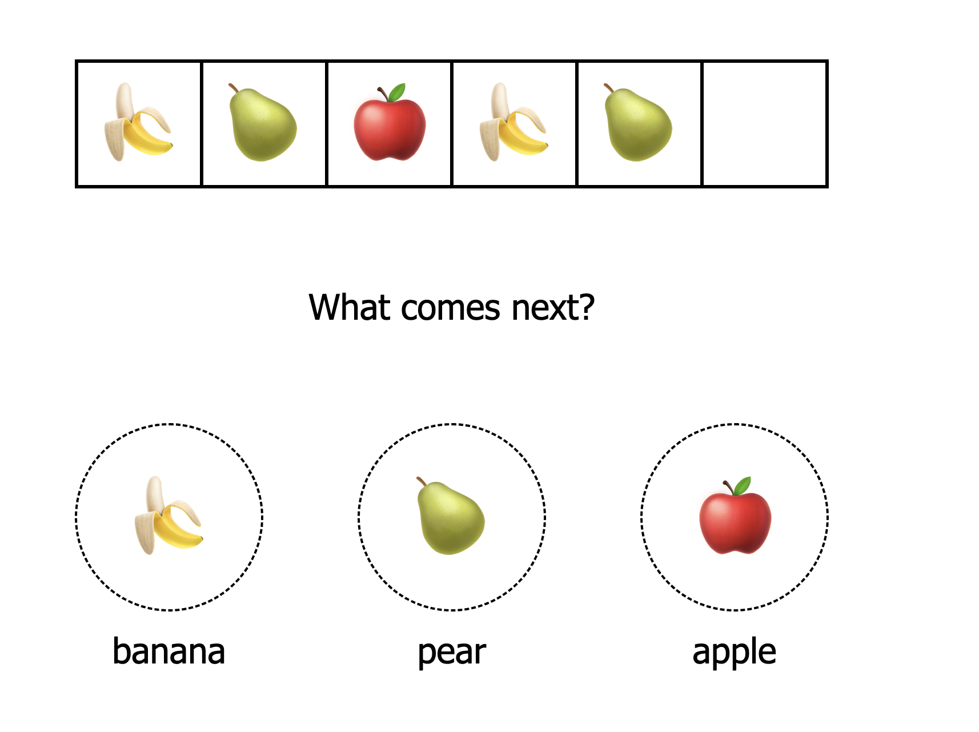
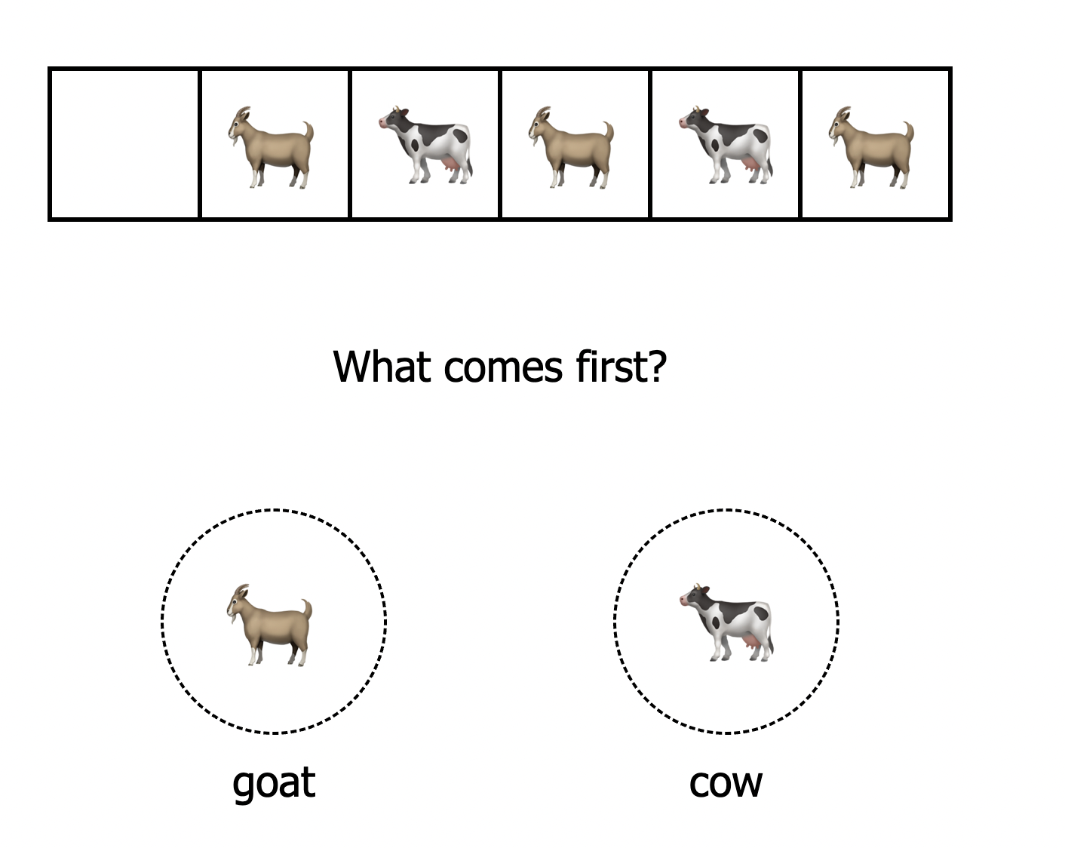
Patterns
BACK
HOME

Slide 10

Patterns
BACK
HOME

